Slide 1

Web Design and Development
Jiri Kral
Dr. Jose Ortiz
CIS3610
Fall 2021

Slide 2

“We aim to create new groundbreaking projects, new in both form and content, which would explore the full potential of competitive swimming and secure sustainable commercial growth in the sport.” - ISL
About ISL…
Club competition
Regular seasons
Financial incentives
Best swimmers in the world
12 men and 12 women per team
Zero doping tolerance

Slide 3
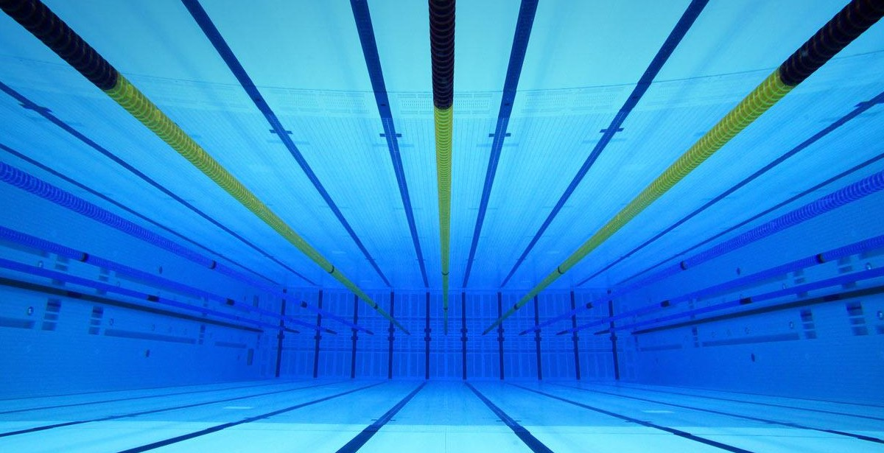
Project Description
Swimming fan platform
Information about ISL, teams, and current state of the competition.
Project Goal
ISL promotion
Excitements
Commercial growth

Slide 4
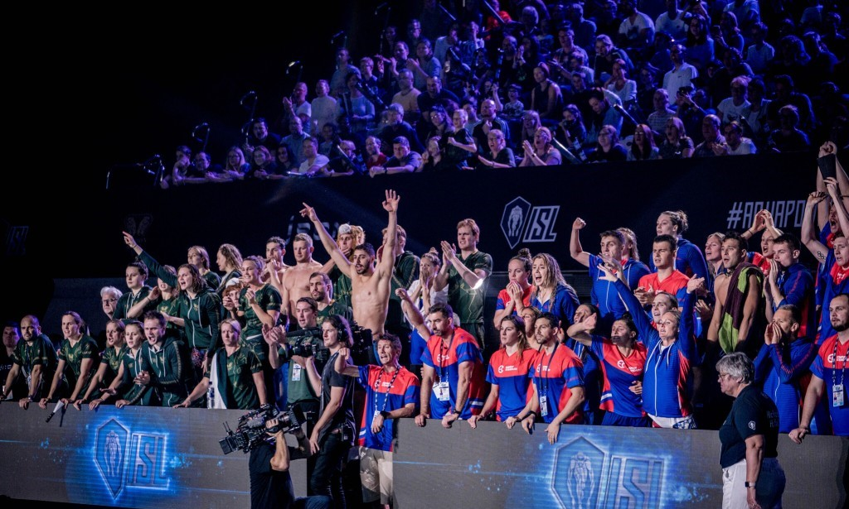
Target Audience
General sport fans audience
Swimmers from all around the world
Visitor’s Motivation
Acquiring information about ISL
Current state of the league
Roaster, schedule, and results

Slide 5
INTERNATIONAL SWIMMING LEAGUE
Take Your Mark

Slide 6
Implementations and Challenges…
… but mostly challenges.

Slide 7
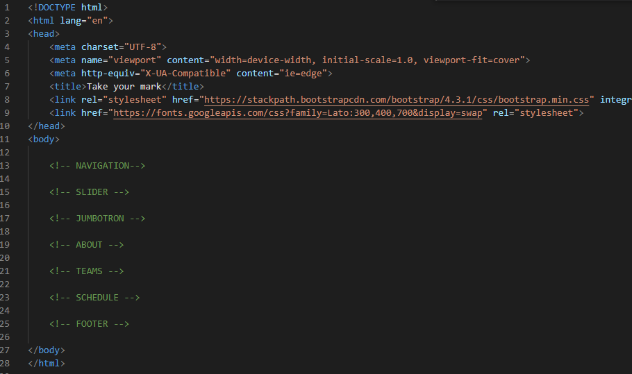
HTML & CSSS
Building HTML from zero
Sources:
Labs
Udemy
3W Schools
YouTube Web Dev channels

Slide 8
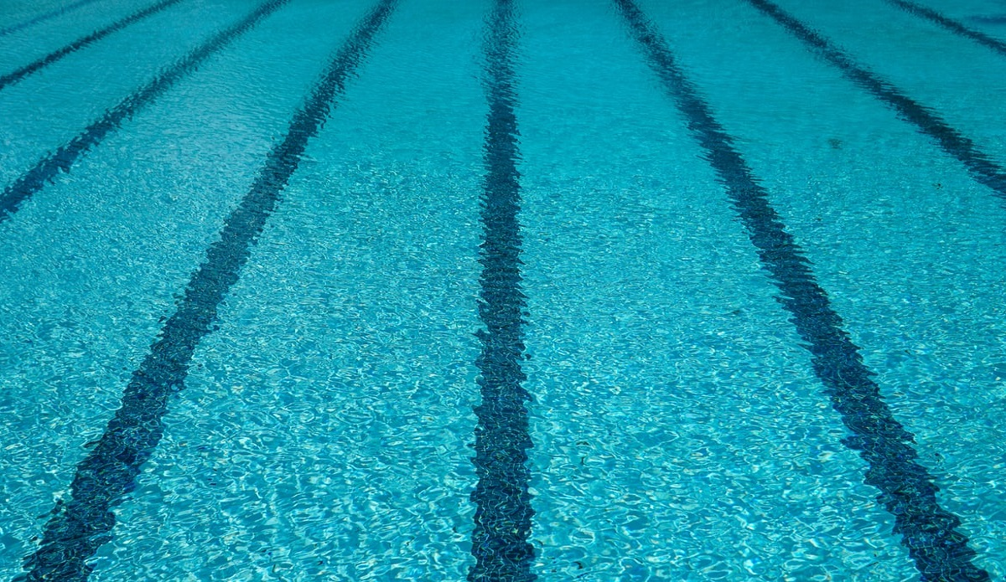
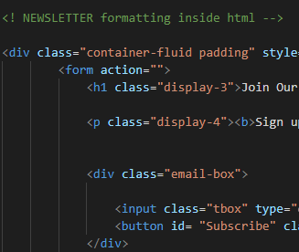
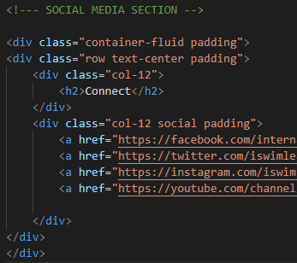
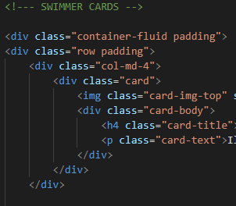
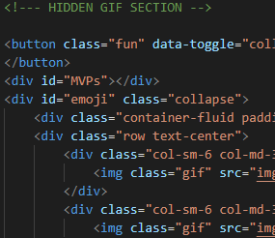
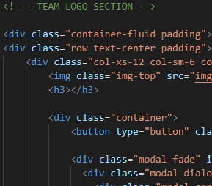
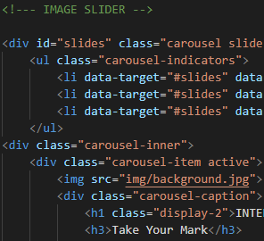

Slide 9
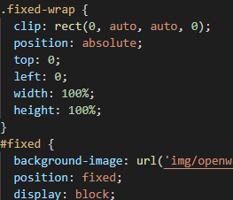
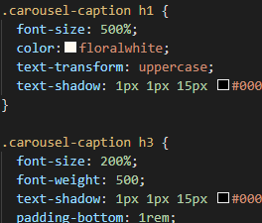
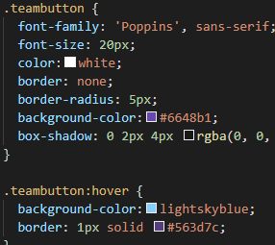
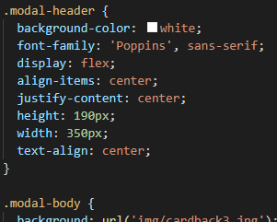
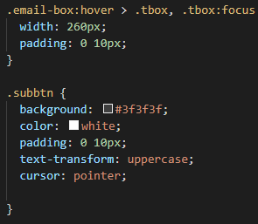
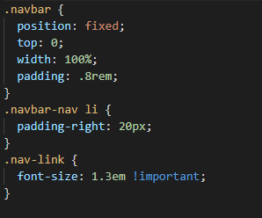

Slide 10
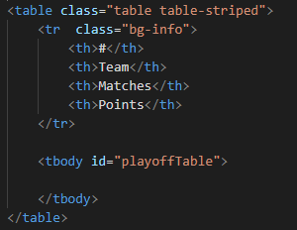
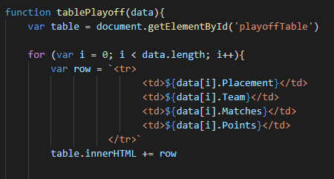

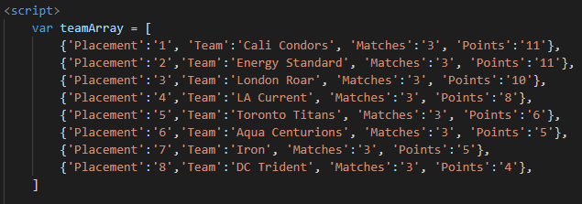
Playoff Table
Array
Function with “for” loop

Slide 11
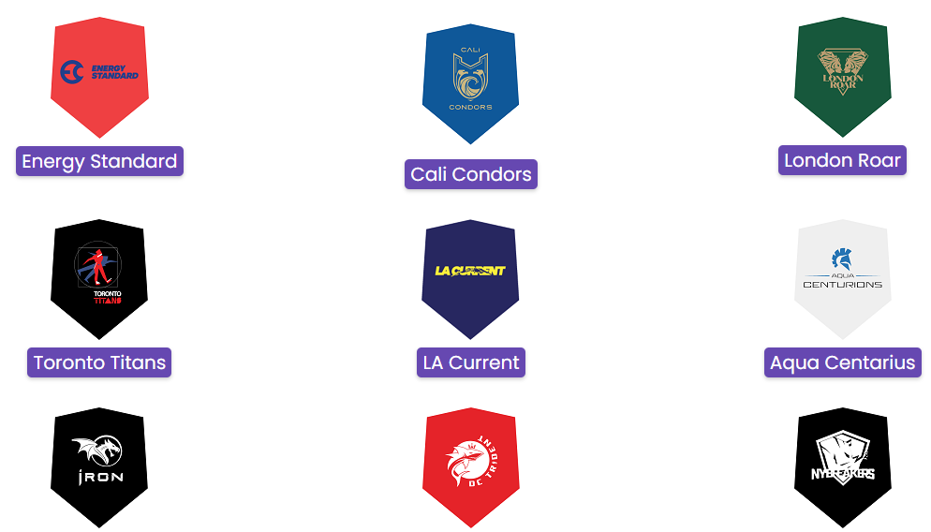
One of the biggest challenges: Team Cards
Goal:
Pop-up team cards upon the button click
Attempts:
Collapsible containers (JS)
Modals (JS)
Modals (Bootstrap)
Issues:
Conflict between the Bootstrap CSS and custom CSS file

Slide 12
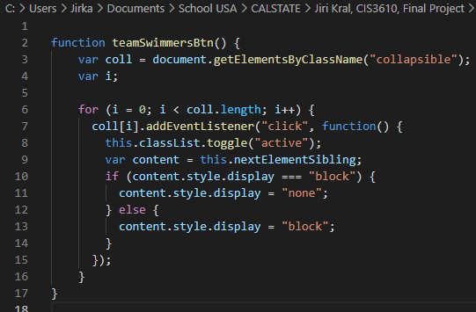
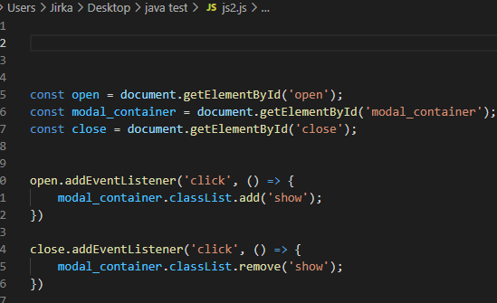

Slide 13
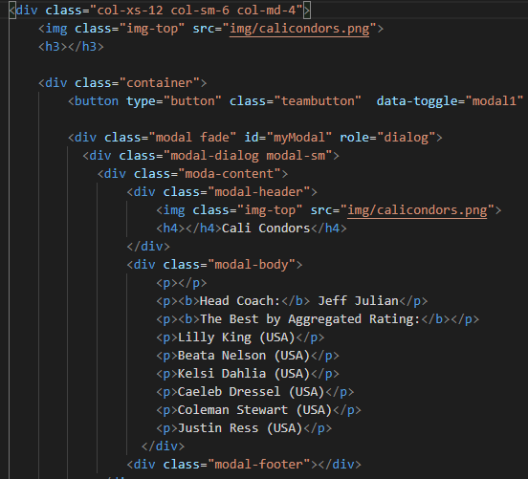
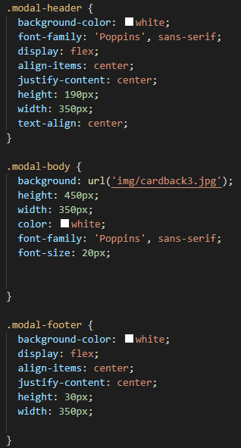

Slide 14


Reflection…
Expectations vs Reality
Self-learning
Practice makes better (and maybe one day even perfect, exactly like in the swimming.)

